Slide 1

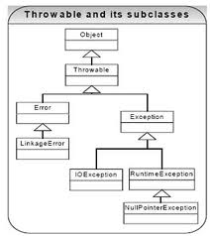
CS/CE 2336 Computer Science II
UT
D
Review: OO – Inheritance & Polymorphism
Adapted from D. Liang’s “Introduction to Java Programming, 9th ed.”

Slide 2
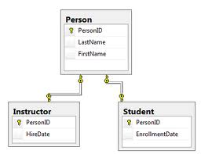
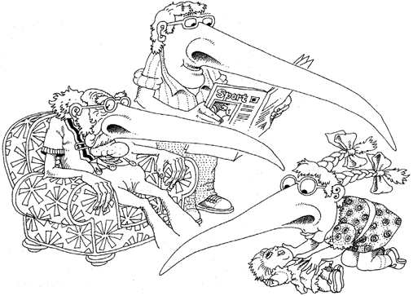
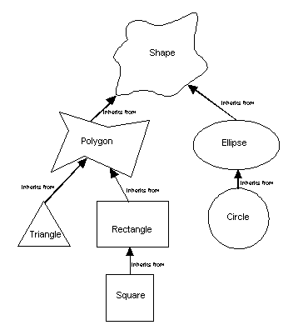

Slide 3
Encapsulation: Class Abstraction
Class abstraction: to separate class implementation from the use of the class
The creator of the class provides an interface of the class and let the user know how the class can be used via the interface
The user of the class does not need to know how the class is implemented
The detail of implementation is encapsulated and hidden from the user
What is the key benefit of encapsulation
from the programming perspective?

Slide 4
Inheritance!
G. Booch et al., Object-Oriented Analysis and Design with Applications

Slide 5
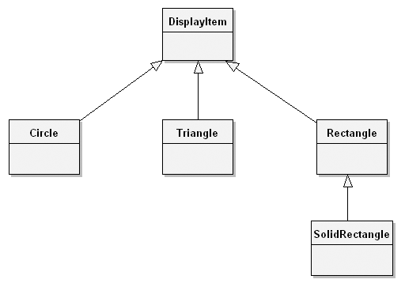
Inheritance Example
Superclass
Subclass
What is the key benefit of inheritance
from the programming perspective?

Slide 6
Are Constructors Inherited?
No, they are not inherited
They are invoked explicitly or implicitly
Explicitly using the super keyword
A constructor is used to construct an instance of a class. Unlike properties and methods, a superclass's constructors are not inherited in the subclass.
They can only be invoked from the subclasses' constructors, using the keyword super. If the keyword super is not explicitly used, the superclass's no-arg constructor is automatically invoked.

Slide 7
Superclass’s Constructor Is Always Invoked
A constructor may invoke an overloaded constructor or its superclass’s constructor. If none of them is invoked explicitly, the compiler puts super() as the first statement in the constructor. For example,

Slide 8
Using the Keyword super
The keyword super refers to the superclass of the class in which super appears
This keyword can be used in two ways:
To call a superclass constructor
To call a superclass method

Slide 9
CAUTION!
The keyword super must be used to call the superclass constructor explicitly
Invoking a superclass constructor’s name in a subclass causes a syntax error
Java requires that the statement that uses the keyword super appear first in the constructor

Slide 10
Example on the Impact of a Superclass without no-arg Constructor
What is wrong with the following program?
public class Apple extends Fruit {
}
class Fruit {
public Fruit(String name) {
System.out.println("Fruit's constructor is invoked");
}
}

Slide 11
Subclassing: Declaring a Subclass
A subclass extends properties and methods from the superclass
By subclassing one can
Add new properties
Add new methods
Override the methods of the superclass

Slide 12
The Object Class and Its Methods
Every class in Java is descended from the java.lang.Object class. If no inheritance is specified when a class is defined, the superclass of the class is Object.

Slide 13
The toString() method in Object
The toString() method returns a string representation of the object. The default implementation returns a string consisting of a class name of which the object is an instance, the at sign (@), and a number representing this object.
Loan loan = new Loan();
System.out.println(loan.toString());
The code displays something like Loan@15037e5 . This message is not very helpful or informative. Usually you should override the toString method so that it returns a digestible string representation of the object.

Slide 14
Polymorphism
poly: many
morph: form
How can we easily handle a variety of objects of the same kind?
http://bip.weizmann.ac.il

Slide 15
Polymorphism, Dynamic Binding and Generic Programming
Method m takes a parameter of the Object type. You can invoke it with any object.
public class PolymorphismDemo {
public static void main(String[] args) {
m(new GraduateStudent());
m(new Student());
m(new Person());
m(new Object());
}
public static void m(Object x) {
System.out.println(x.toString());
}
}
class GraduateStudent extends Student {
}
class Student extends Person {
public String toString() {
return "Student";
}
}
class Person extends Object {
public String toString() {
return "Person";
}
}
An object of a subtype can be used wherever its supertype value is required. This feature is known as polymorphism.
When the method m(Object x) is executed, the argument x’s toString method is invoked. x may be an instance of GraduateStudent, Student, Person, or Object. Classes GraduateStudent, Student, Person, and Object have their own implementation of the toString method. Which implementation is used will be determined dynamically by the Java Virtual Machine at runtime. This capability is known as dynamic binding.

Slide 16
Dynamic Binding
Dynamic binding works as follows: Suppose an object o is an instance of classes C₁, C₂, ..., C_{n-1}, and C_{n}, where C₁ is a subclass of C₂, C₂ is a subclass of C₃, ..., and C_{n-1} is a subclass of C_{n}. That is, C_{n} is the most general class, and C₁ is the most specific class. In Java, C_{n} is the Object class. If o invokes a method p, the JVM searches the implementation for the method p in C₁, C₂, ..., C_{n-1} and C_{n}, in this order, until it is found. Once an implementation is found, the search stops and the first-found implementation is invoked.

Slide 17
Casting Objects
Two uses of casting operator:
Convert variables of one primitive type to another
Convert an object of one class type to another within an inheritance hierarchy. For example
m(new Student());
assigns the object new Student() to a parameter of the Object type. This statement is equivalent to:
Object o = new Student(); // Implicit casting
m(o);
The statement Object o = new Student(), known as implicit casting, is legal because an instance of Student is automatically an instance of Object.

Slide 18
Why Casting Is Necessary?
Suppose you want to assign the object reference o to a variable of the Student type using the following statement:
Student b = o;
A compilation error would occur. Why does the statement Object o = new Student() work and the statement Student b = o doesn’t? This is because a Student object is always an instance of Object, but an Object is not necessarily an instance of Student. Even though you can see that o is really a Student object, the compiler is not so clever to know it. To tell the compiler that o is a Student object, use an explicit casting. The syntax is similar to the one used for casting among primitive data types. Enclose the target object type in parentheses and place it before the object to be cast, as follows:
Student b = (Student)o; // Explicit casting

Slide 19
The ArrayList Class
You can create an array to store objects. But the array’s size is fixed once the array is created. Java provides the ArrayList class that can be used to store an unlimited number of objects.

Slide 20
Comparison of Array and ArrayList

Slide 21
The protected Modifier
The protected modifier can be applied on data and methods in a class. A protected data or a protected method in a public class can be accessed by any class in the same package or its subclasses, even if the subclasses are in a different package.
Visibility modifiers
private, default, protected, public

Slide 22
Accessibility Summary

Slide 23
Visibility Modifiers

Slide 24
The final Modifier
The final class cannot be extended:
final class Math {
...
}
The final variable is a constant:
final static double PI = 3.14159;
The final method cannot be overridden by its subclasses.

